Slide 1
Revenue, Returns & Product Reliability and Customer Profitability Analysis
- A Case Study by Anik Chakraborty

Slide 2
🎯 Objective
Project Purpose:
To analyze retail performance across Returns, Revenue, and Profitability and uncover actionable business insights. And also, help stakeholders identify revenue drivers, minimize returns, and maximize profitability.
Key KPIs:
Total Orders
Total Revenue
Total Profit
Return Rate (%)
Average Order Value (AOV)
Profit Margin (%)
Total Customers / Returned Products
Deliverables:
3 Interactive Power BI Dashboards
Revenue Performance
Returns & Product Reliability
Customer Profitability
Business insights & recommendations
Data-driven decision support framework

Slide 3
📘 Project Overview
Context Highlights:
This project analyzes a multi-category retail business to evaluate performance gaps, risks, and profitability drivers. In a competitive retail environment, understanding what drives revenue and what causes losses is critical.
The business deals with product categories such as Bikes, Accessories, and Clothing, with revenue heavily concentrated in select segments.
Key challenges identified include:
High product return rates, impacting overall efficiency
Revenue concentration in limited categories, increasing business risk
Variations in customer profitability, indicating uneven value distribution
This analysis was designed to identify inefficiencies and uncover actionable, data-driven insights.
The objective is to transform raw transactional data into meaningful insights and strategic business decisions using Power BI.

Slide 4
🗂️ Data Overview & Schema
Data Source:
Source: Structured retail dataset (Sales, Products, Customers, Returns, Territories)
Data Type: Relational (Fact + Dimension tables)
Time Period: 2015 – 2017
Data Structure & Metrics:
Key Index Types: ProductKey, CustomerKey, TerritoryKey, OrderNumber
Categories: Bikes, Accessories, Clothing
Fact Table: sales_combined
Dimension Tables: customers, products, product_categories, territories, returns
Calculated Metrics:
Revenue = Quantity × Price
Profit = Quantity × (Price – Cost)
Return Rate = Returns / Sales
Profit Margin = Profit / Revenue
Income Groups (Low / Middle / High)

Slide 5
💻 Tech Stack
Tools:
SQL
Data extraction & business question analysis
PowerQuery
Data Transformation & Shaping
Column Standardization
Data Preparation for BI Integration
PowerBI
Dashboard & Visualization
Data Modeling & Relationship Building
DAX – KPI Calculations Columns & Measures
Slicers & Dynamic Filtering
PowerPoint
Presentation and final dashboard snapshots

Slide 6
📈 Methodology & Analysis
Preparation, Process & Analytical Approach:
Data Preparation & Cleaning:
Removed null values & inconsistencies
Fixed date hierarchy issues
Standardized product & customer attributes
Data Modeling & Integration:
Built star schema model
Established relationships between fact & dimension tables
Feature Engineering:
Profit & Revenue measures
Return Rate
Growth % (MoM)
Income segmentation
Visualization Design:
Designed 3 business-focused dashboards
Used clear KPI cards & supporting visuals
Consistent color theme & layout
Validation & Formatting:
Accurate KPI calculations
Consistent formatting
User-friendly layout & slicers

Slide 7
❓ Problem Statement
To address the business challenges and uncover meaningful insights, this analysis focuses on answering critical questions related to revenue generation, return risks, and customer behavior. The objective is to identify key drivers of performance, areas of inefficiency, and opportunities for growth across products, customers, and regions.
Key Questions:
Which products and categories drive maximum revenue and profit?
Which products have high return rates and why?
Are sales growing consistently over time?
Which customers contribute the most to revenue and profit?
How does customer behavior vary by income, gender, and geography?
Which regions and segments are underperforming?

Slide 8
💡 Key Insights
Top Findings:
Bikes category dominates revenue (~5.2M) while others contribute minimally.
Return Rate is ~11.64%, indicating significant product quality or expectation issues.
Certain products (e.g., Road & Mountain series) show high return rates → risk area.
Revenue trend shows fluctuations, with peak growth in mid-2016.
Profit is highly concentrated in specific models (Mountain-200).
Middle-income customers contribute highest profit, showing strong purchasing power.
Supporting Metrics:
Total Revenue: 5.42M
Total Profit: 2.35M
Profit Margin: ~43%
Total Returns: 1,828
Top Product Revenue: ~0.45M
Top Model Profit: ~1.16M

Slide 9
📍Conclusion
Summary:
The business is revenue-strong but operationally inefficient due to returns.
Profitability is concentrated, indicating dependency on limited products.
Customer segmentation reveals high-value target groups.
Focus should be on:
Reducing returns
Diversifying revenue sources
Targeting high-profit customer segments

Slide 10
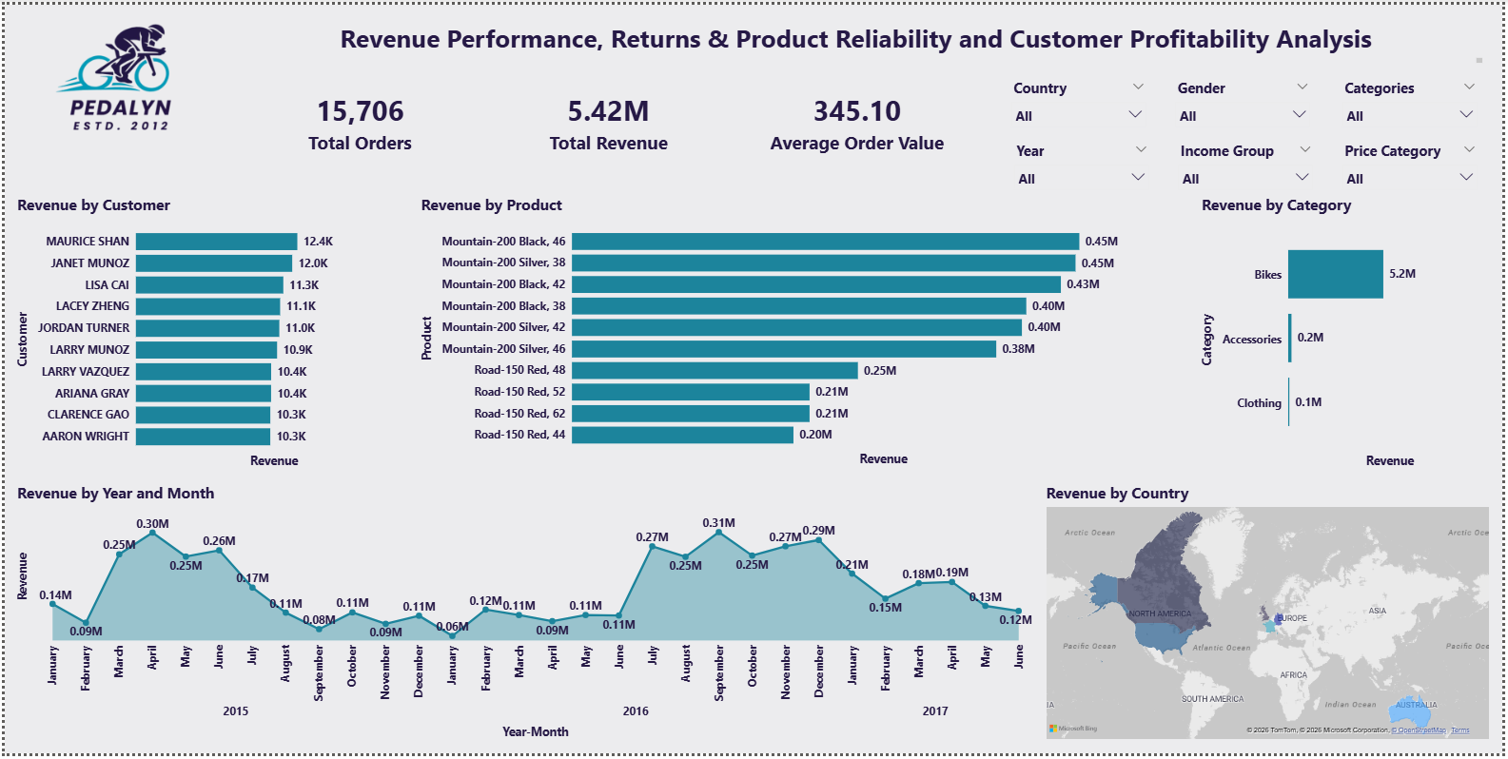
🖥️ Dashboard Overview (1) – Revenue Performance

Slide 11
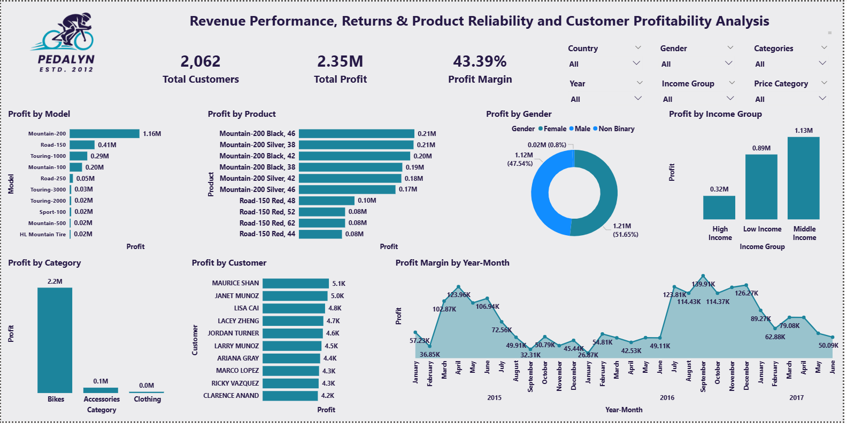
🖥️ Dashboard Overview (2) – Returns & Product Reliability

Slide 12

🖥️ Dashboard Overview (3) – Customer Profitability

Slide 13
✅ Business Impact & Use Cases
This analysis translates data insights into practical business actions that drive measurable impact across operations, marketing, and strategy. By leveraging data-driven findings, the business can reduce inefficiencies, enhance customer targeting, and improve overall profitability, enabling smarter and more informed decision-making.
Helps reduce return losses by identifying problem products. Pinpoints products with high return rates, enabling businesses to investigate root causes like quality issues, pricing mismatch, or customer expectations, and take corrective actions.
Enables targeted marketing for high-value customers. Identifies top-performing customer segments based on revenue and profitability, allowing for personalized campaigns, better engagement, and higher conversion rates.
Supports inventory & pricing decisions. Provides insights into high-demand and low-performing products, helping optimize stock levels, avoid overstocking, and implement competitive pricing strategies.
Assists leadership in data-driven strategic planning. Offers a clear view of business performance across products, regions, and customers, enabling leaders to make informed, strategic decisions backed by data.
Improves profitability through product & segment optimization. Highlights high-margin products and profitable segments, allowing the business to focus resources, refine offerings, and maximize overall profitability.

Slide 14
🙏 Acknowledgement & Contact
Project Analyst: Anik Chakraborty 📧 Email: anikc1710@gmail.com
Special Thanks To:
Coding Ninjas – for project framework and guidance
Connect: 🔗 GitHub | 🔗 LinkedIn

Slide 15
Thank You!

